Slide 1


Home
About Us
Contact
udget
Boss
No more loss with Budget Boss.

Slide 2



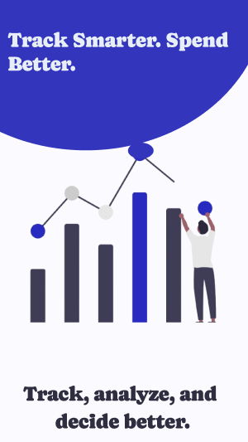
Home
About Us
Contact
Welcome
to
Budget Boss
Budget Boss is a cross-platform mobile application designed to help users effortlessly manage their personal finances.
Whether you're a student juggling a limited budget, a young professional saving for future goals, or a freelancer separating business and personal expenses, Budget Boss aims to make financial tracking simple and intuitive.

Slide 3
Home
About Us
Contact
Problem
Statement
Many people struggle to track spending.
Manual tracking is tedious and inefficient.
Users need a visual, intelligent, and simple way to manage money.
Goal: Help users track, analyze, and manage expenses efficiently using mobile tech.

Slide 4
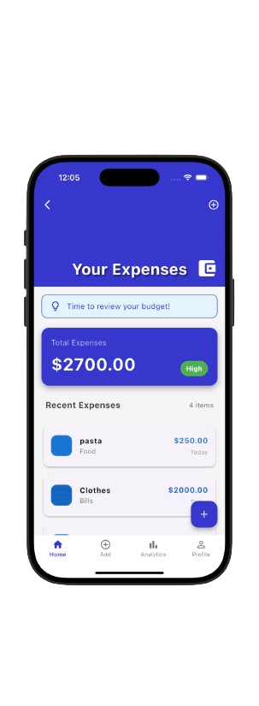

Home
About Us
Contact
Solution
Expense Tracking:
Allow users to add, edit, and categorize expenses quickly.
Provide real-time summaries of daily, weekly, and monthly spending.
Budget Management:
Enable users to set and monitor budgets for different categories (e.g., food, bills).
Data Visualization:
Offer simple charts and graphs to display spending patterns.
Help users identify areas where they can save more.
User-Friendly Experience:
Design an intuitive interface suitable for non-tech-savvy users.
Implement features like auto-categorization and quick expense entry.
Accessibility & Security:
Safeguard user data with local storage and optional cloud backup.
Goal Setting:
Allow users to set financial goals (e.g., saving for a vacation).
Track progress.
Overview

Slide 5
Home
About Us
Contact
Target Users
Young Professionals:
Need to track daily expenses and monthly budgets.
Want to save for goals like vacations, gadgets, or investments.
Students:
Manage limited budgets for food, books, and entertainment.
Keep track of allowances or part-time job earnings.
Families & Homemakers:
Track household expenses (groceries, bills, children’s needs).
Plan family budgets and future savings.

Slide 6
Home
About Us
Contact
Functional
USER AUTHENTICATION & MANAGEMENT
Sign up/login via email & password.
Requirment
EXPENSE TRACKING
Add, edit, and delete transactions with amount, category, date and notes.
BUDGET MANAGEMENT
Set budgets for specific categories.
FINANCIAL OVERVIEW & INSIGHTS
Visual spending trends via charts/graphs.

Slide 7

Home
About Us
Contact
Non -Functional
Performance:
Requirements
Loads within 3 seconds.
Usability & UX
Intuitive, user-friendly interface with easy navigation.
Scalability
Handles thousands of users without performance issues.
Reliability & Availability
99.9% uptime with daily automatic backups.
Compatibility
Supports Android (10+) and iOS (12+).
Maintainability
Modular architecture for seamless updates and bug fixes.

Slide 8
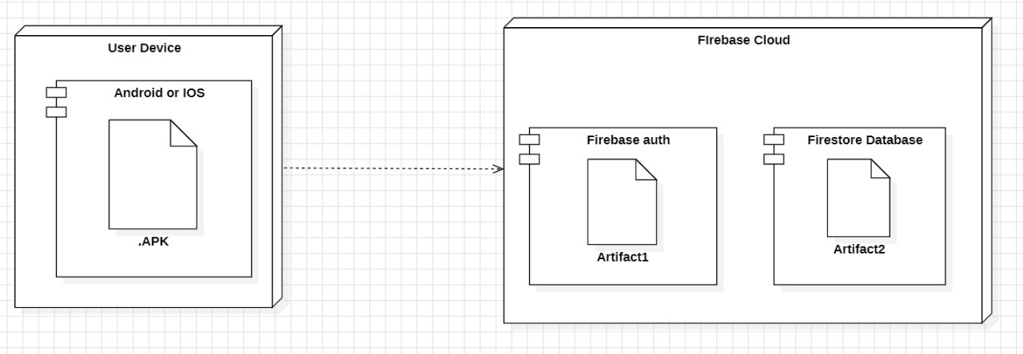
Deployment Diagram

Slide 9
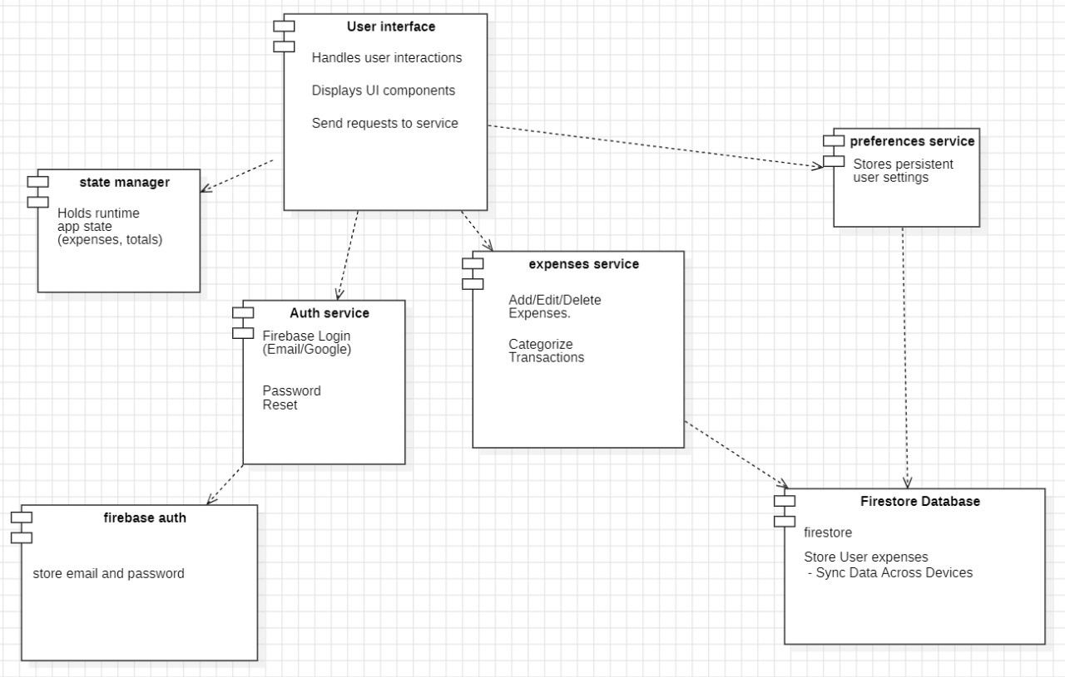
Component Diagram

Slide 10
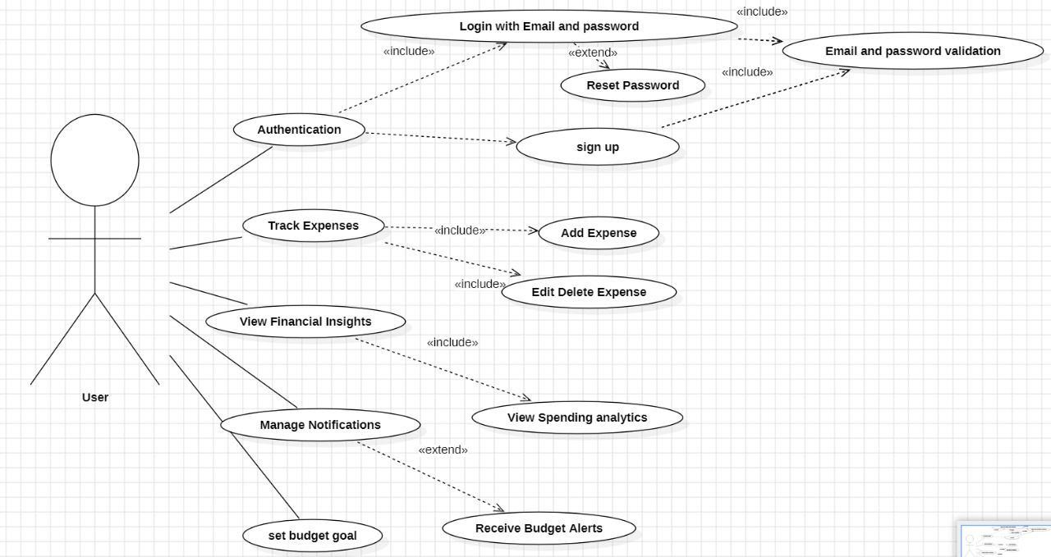
Use case Diagram
page 5

Slide 11
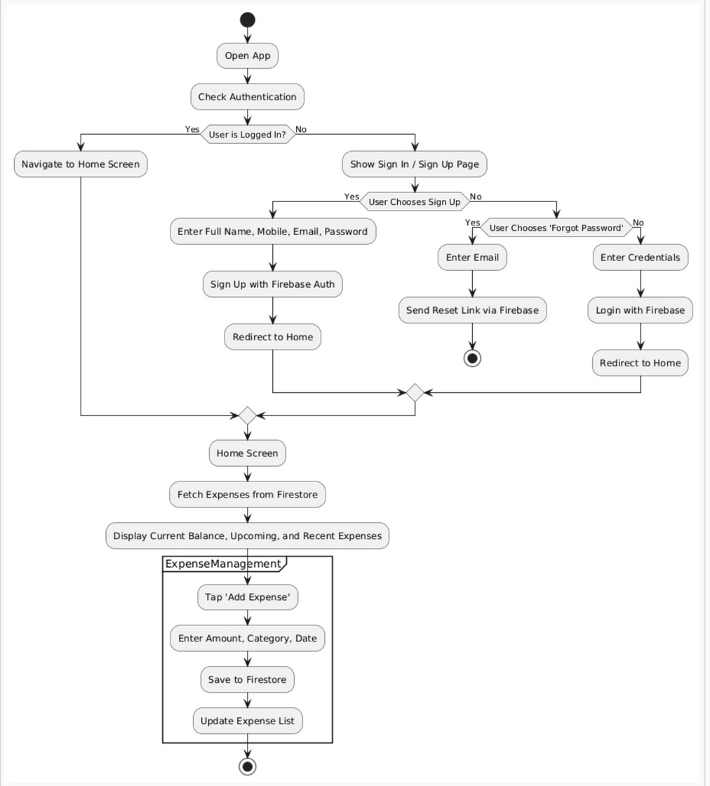
Data Flow Diagram

Slide 12
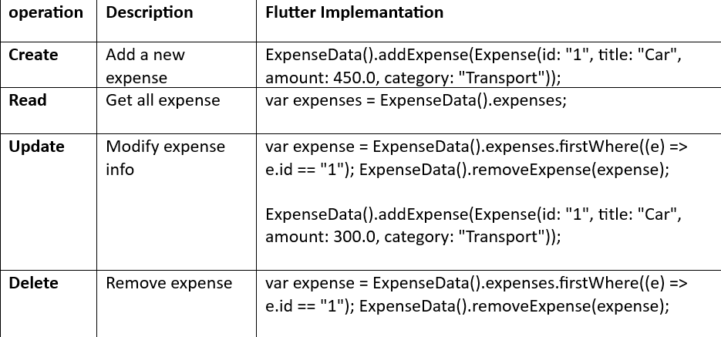
CRUD Matrix

Slide 13
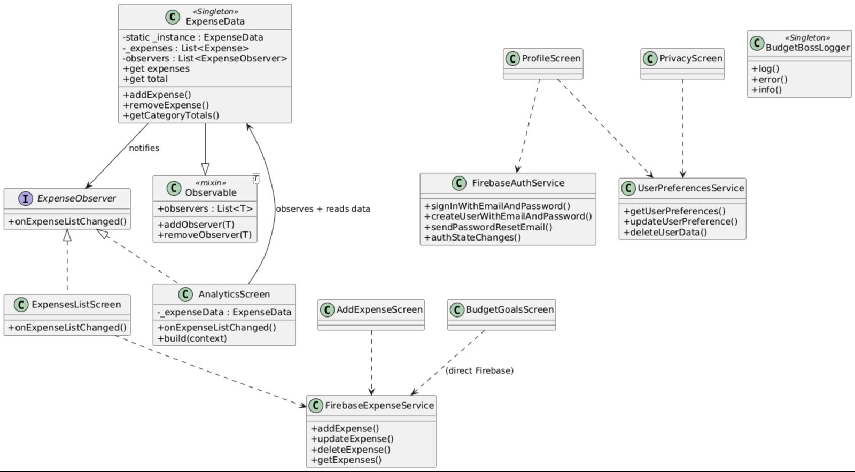
Class Diagram

Slide 14
Design Patterns Used
Pattern | Purpose | Used In
Singleton | Global access & shared state | ExpenseData, Logger
Observer | Reactive UI updates | AnalyticsScreen, List
Service Layer | Clean separation between UI and backend | Firebase*Service classes

Slide 15
SOLID Principles in Budget Boss App
S - Single Responsibility Principle (SRP)
Each service class (FirebaseAuthService, FirebaseExpenseService, UserPreferencesService) is responsible for one concern.
UI screens handle UI only and delegate all business logic to services.
ExpenseData only manages state (expenses) and not UI or services.
O - Open/Closed Principle (OCP)
Services are open for extension (e.g., add new methods) but closed for modification — the existing interface doesn’t need to change.
You can add new preference keys or validation without altering core logic.
L - Liskov Substitution Principle (LSP)
ExpenseObserver implementations (AnalyticsScreen, ExpensesListScreen) can be used wherever an observer is expected.
FirebaseAuthService and FirebaseExpenseService follow expected behaviors without breaking app logic.

Slide 16
SOLID Principles in Budget Boss App
I - Interface Segregation Principle (ISP)
Interfaces and mixins like ExpenseObserver are narrow and focused — they contain only what’s necessary.
No class is forced to implement methods it doesn't need.
D - Dependency Inversion Principle (DIP)
The app depends on abstracted services (FirebaseAuthService, etc.), not Firebase SDK directly.
UI Screens → Service Layer → Firebase ensures modularity and testability.

Slide 17
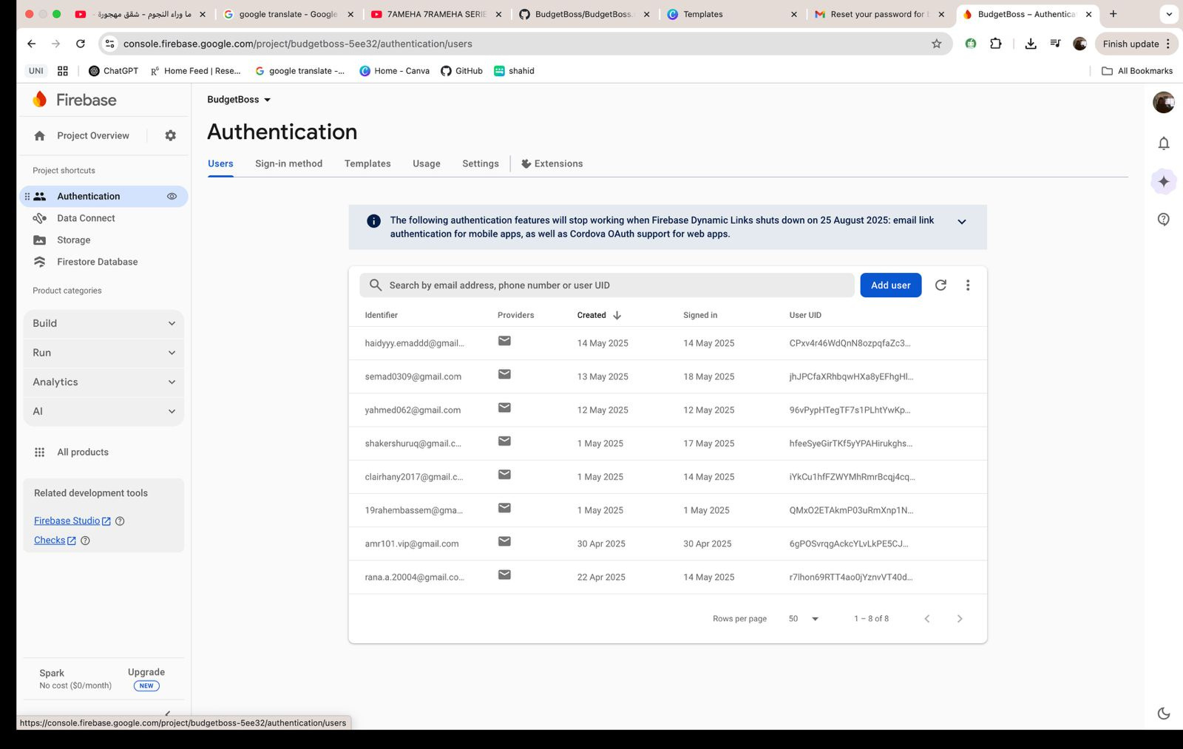
Firebase

Slide 18
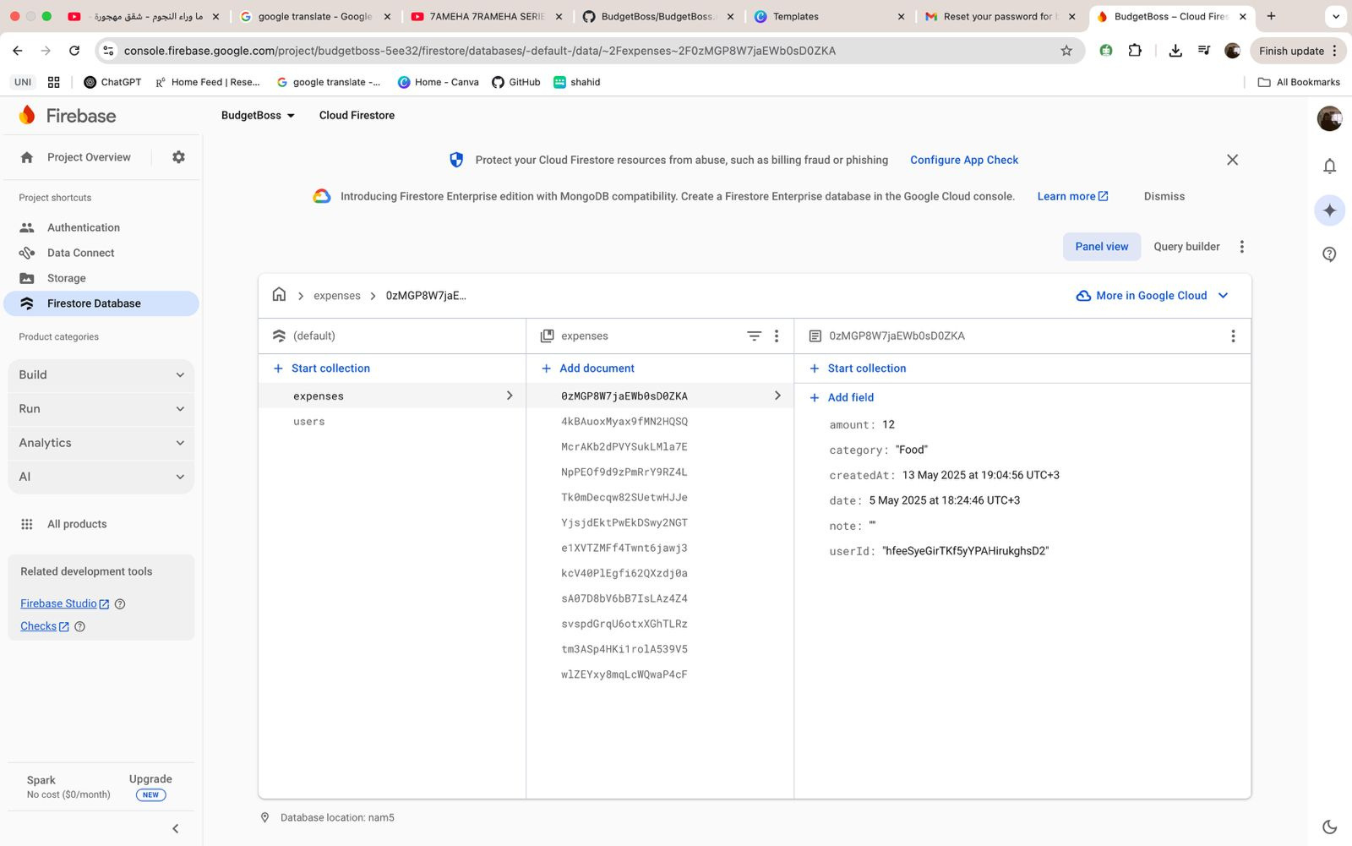
Firebase

Slide 19
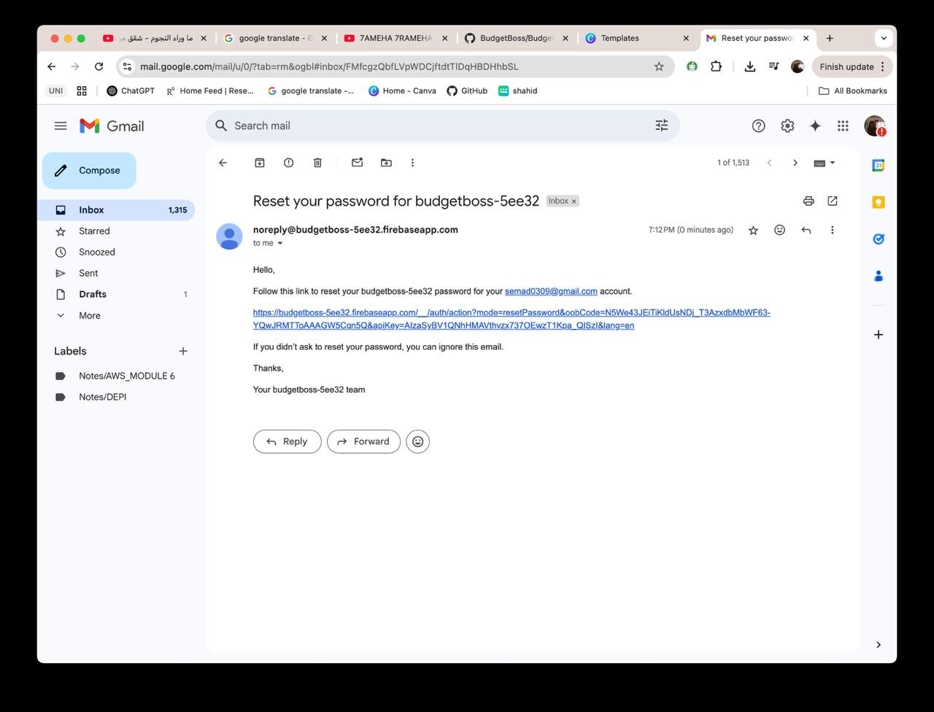
Reset Password

Slide 20
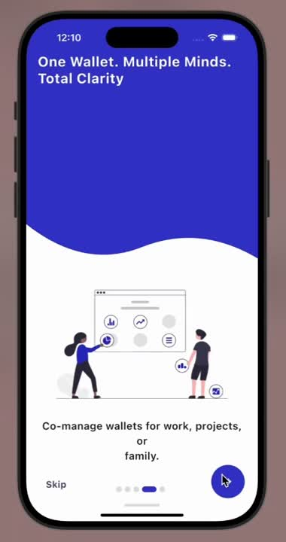

Demo for BudgetBoss

Slide 21
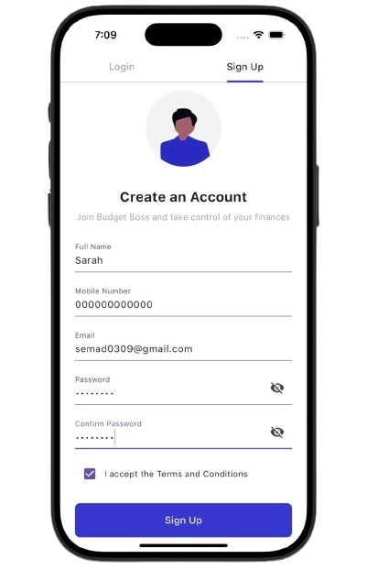
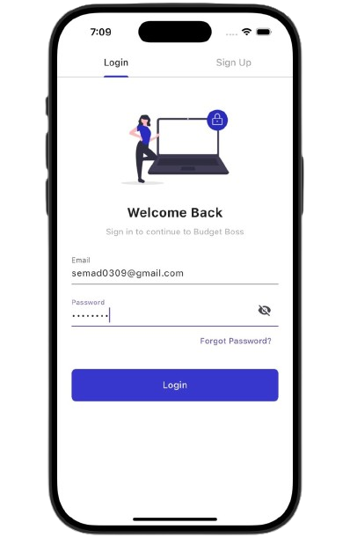
Login and Sign up

Slide 22
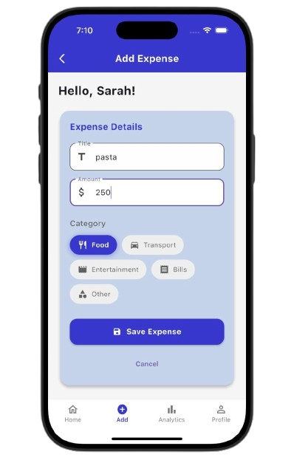
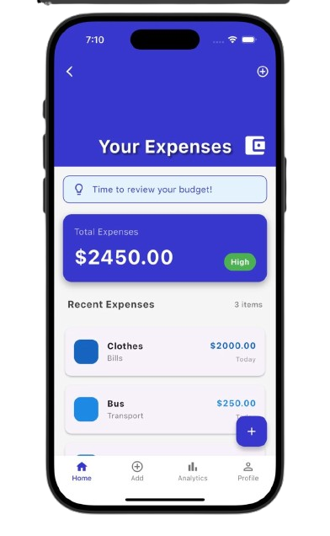
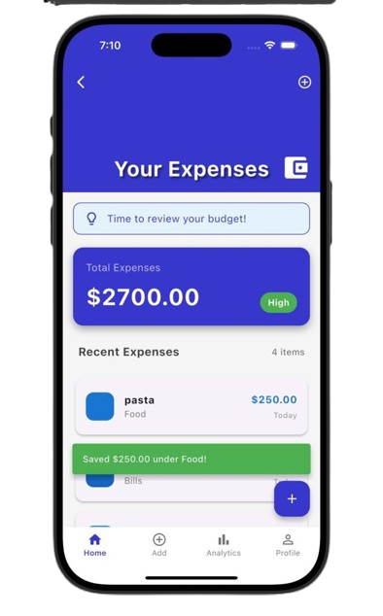
Track your Expenses

Slide 23
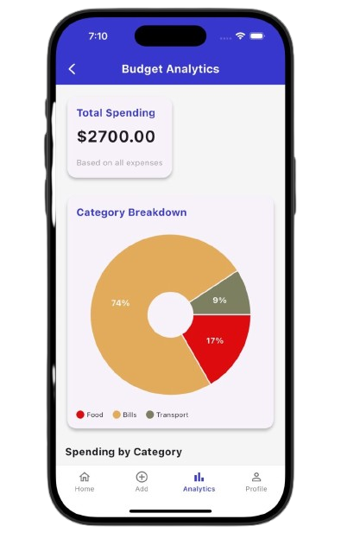
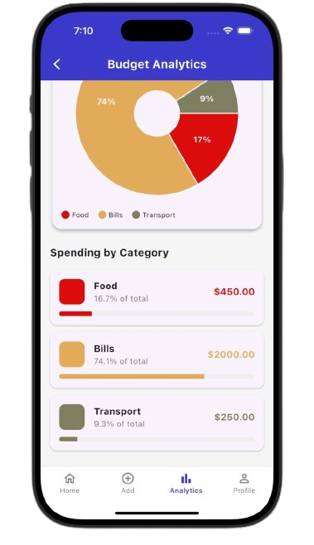
See you personalised Analaysis

Slide 24

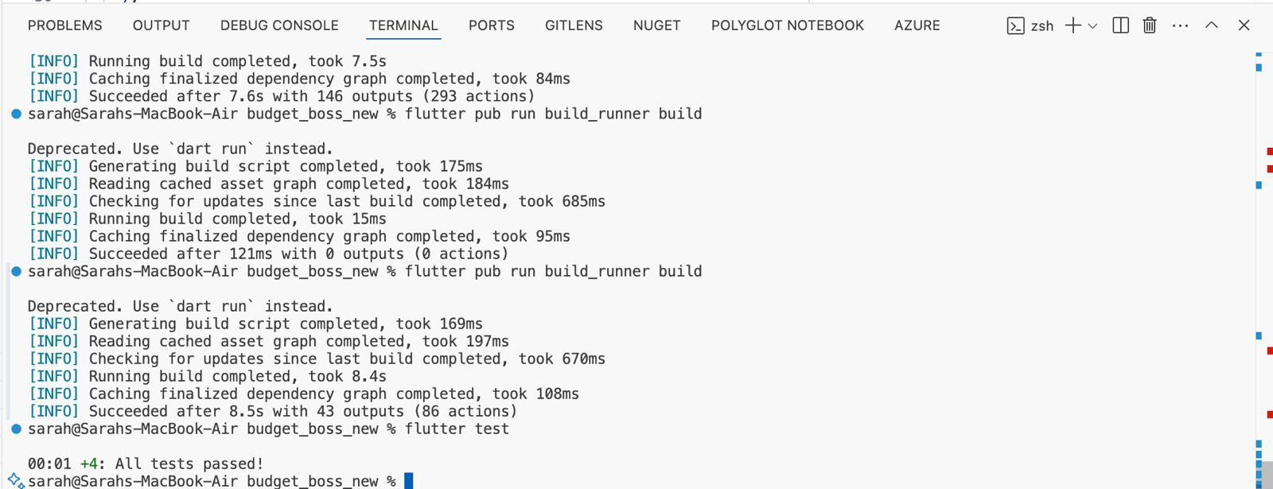
Unit Testing
addExpense
can call with data
getExpense
returns mockerd list
updateExpense
called with correct params
deleteExpense
called with correct id

Slide 25
Home
About Us
Contact
Thank
You!

